Slide 1


PREDICTIVE DEMAND FOR CITIBIKE
TEAM G:
Abhishek Kumar
Tharun Achanta
Leena Goyal
Abhilasha Mehra

Slide 2
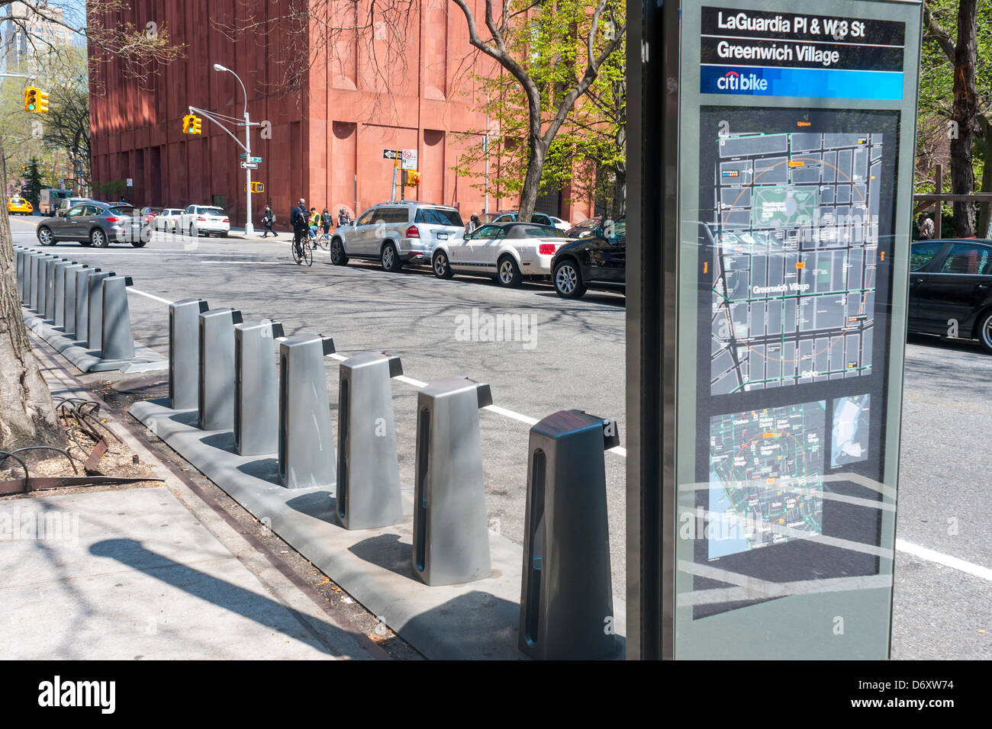
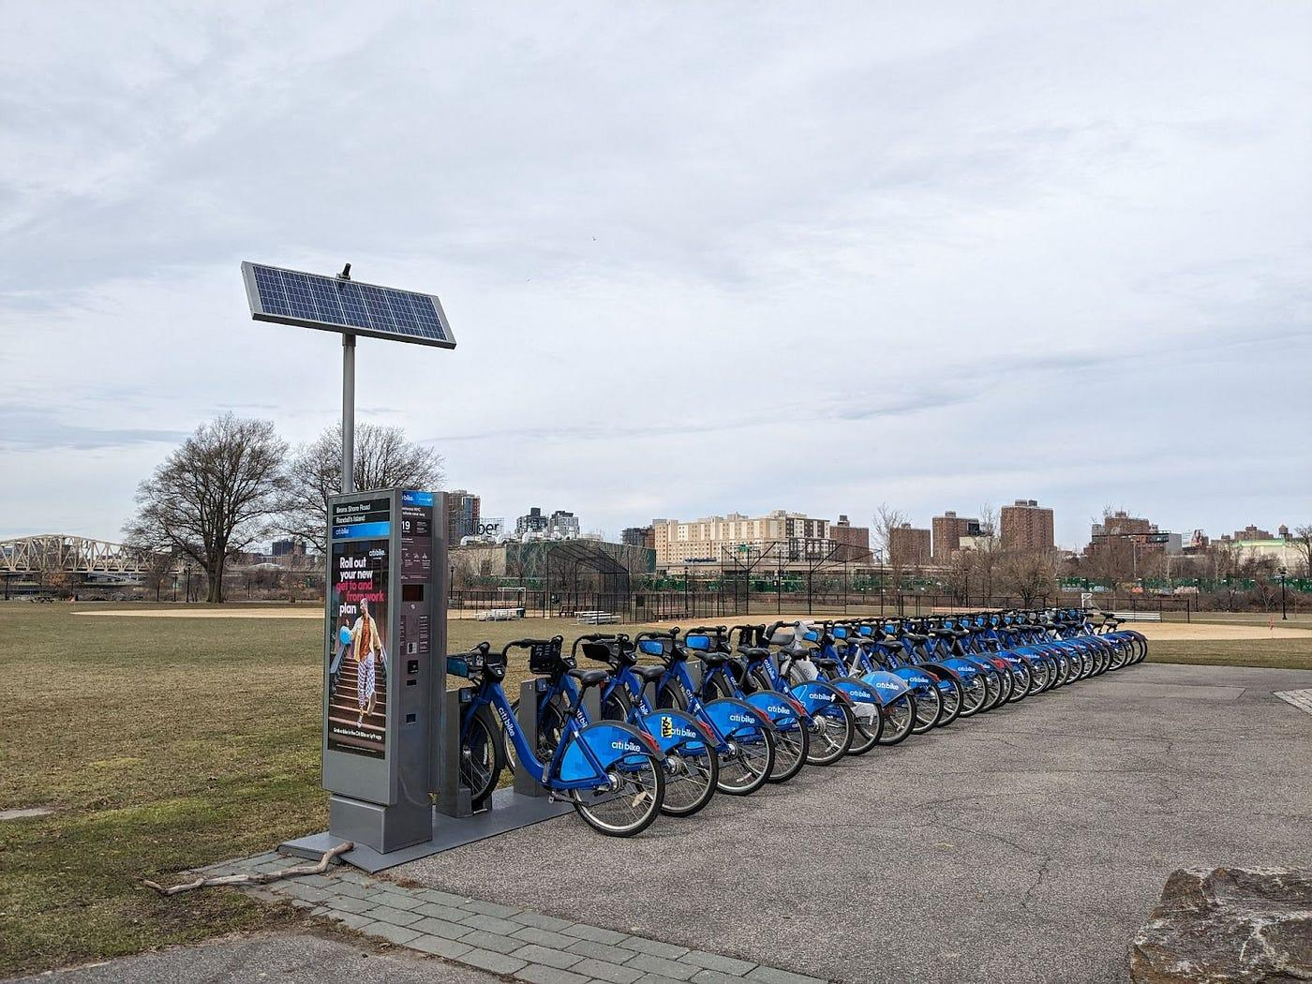
PROBLEM STATEMENT
The Citi Bike program struggles with an ongoing imbalance in bike and dock availability across its network, leading to frequent user frustration when stations lack available bikes or open docks—especially during peak commuting hours. This imbalance disrupts the user experience, reduces satisfaction, and challenges the program’s operational efficiency.
⬅No Bikes
No Docks ➡

Slide 3
OBJECTIVE
Our project aims to design a machine learning solution that accurately predicts bike and dock demand at each station. By forecasting demand based on factors such as time of day, weather, and local events, our solution helps Citi Bike optimize resource allocation and planning. The ultimate goal is to improve operational efficiency and provide a more reliable experience for riders.

Slide 4

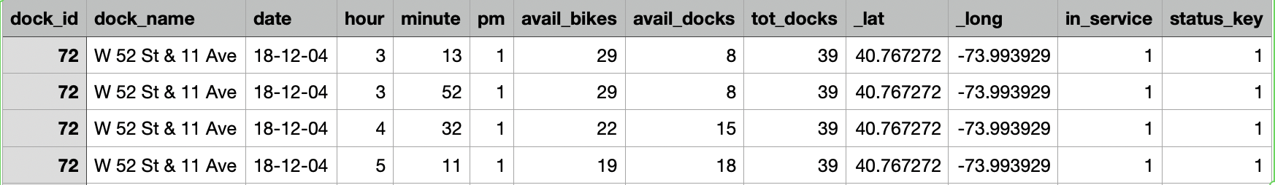
DATA
https://citibikenyc.com/system-data (>10 million rows)
BIKE/DOCK DATA
https://www.theopenbus.com/raw-data.html
WEATHER DATA
https://www.visualcrossing.com/weather/weather-data-services

Slide 5
DATA PROCESSING
1. Acquire All Necessary Data
2. Perform Initial Data Cleaning
3. Upload Cleaned Data to the Cloud Bucket (Multiple CSVs)
4. Integrate Datasets
• Clean Citi Bike data and integrate weather conditions.
5. Create Uniform Time Intervals and Resample Data
• Resample the integrated data to create total inflow and outflow metrics.
6. Perform Final Data Cleaning

Slide 6
SOLUTION OVERVIEW
Data-driven demand prediction
Using historical ride data, we train a model to predict bike and dock demand at each station in New York City based on factors like time of day, day of the week, and season.
Additional variables, such as weather and local events, can also be incorporated to enhance prediction accuracy.
With Apache Spark, Databricks allows me to efficiently process and extract features from historical ride, weather, and holiday data.
Additionally, the MLflow integration on Databricks makes it straightforward to track experiments, version models, and manage deployments, which will be essential as I iterate and improve the prediction model over time.

Slide 7
Dataproc Cluster Config
We used 1 Master N Workers config
Master Node: n2-standard-4
Worker Nodes: We used 5 worker nodes with 4 cores each
We uploaded all the dataset csv files (~320) (2013-2024) into GCP cloud storage bucket and configured this bucket as Cloud Storage staging bucket to Dataproc cluster
We used spark.sql.shuffle.partitions = 20 during creation of spark session to match the total number of cores (5 workers × 4 cores). Ensures parallel shuffle stages are optimal.

Slide 8
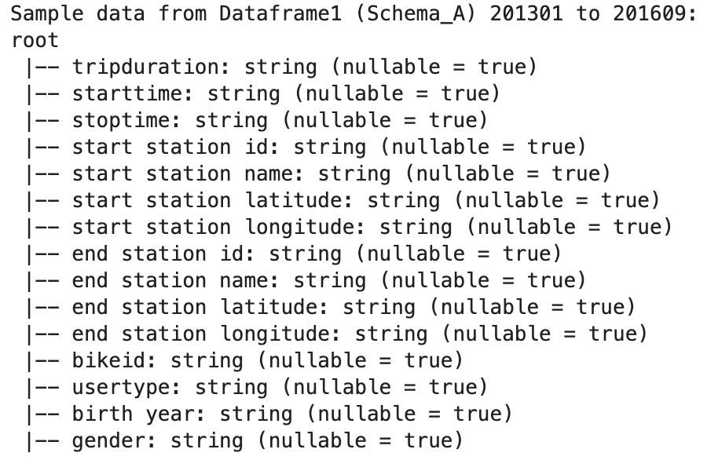
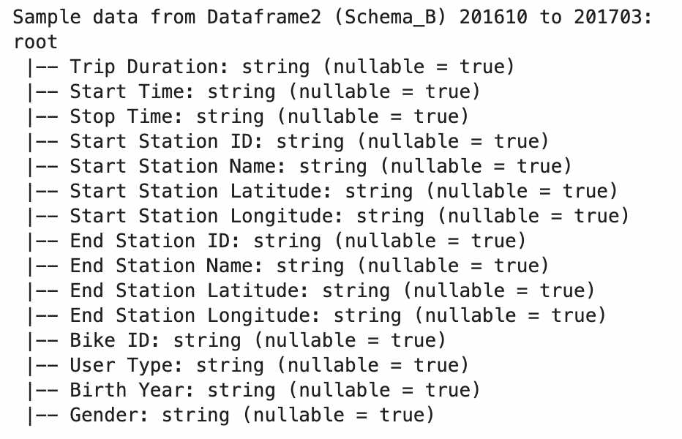
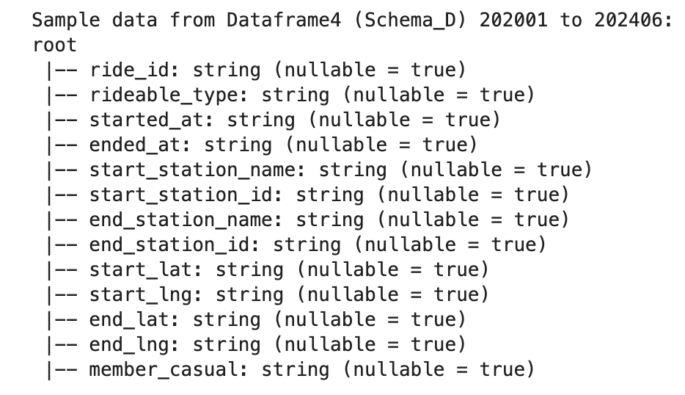
Data Preprocessing
Schema Change Over time
After loading data into GCP, we first checked if the data across all csv files have same schema or not.
During our analysis we found that the Citi Bike trip data had schema changes multiple times over the years

Slide 9
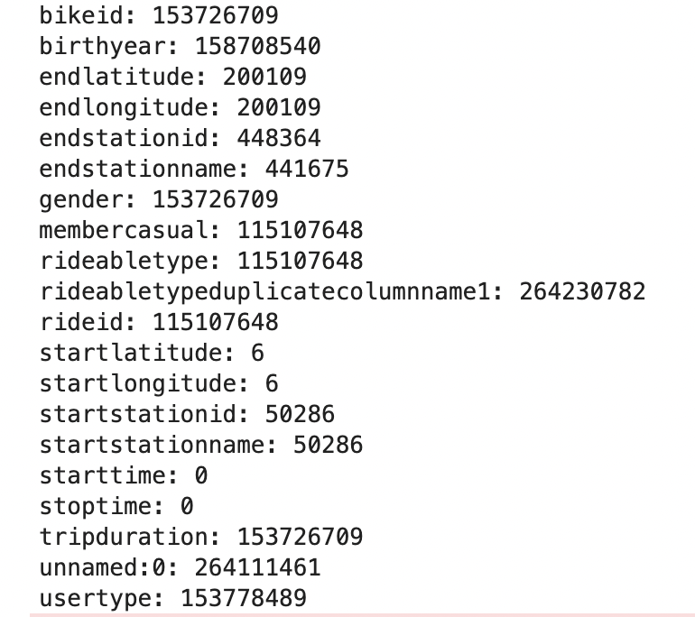
Data Preprocessing
Schema Change Over time
Based on our analysis, we used a predefined schema mapping to merge columns with different names into one
We also found many null values in each
column because of the schema changes
over years
But for our task of demand prediction we are
only using start time and start station
information

Slide 10
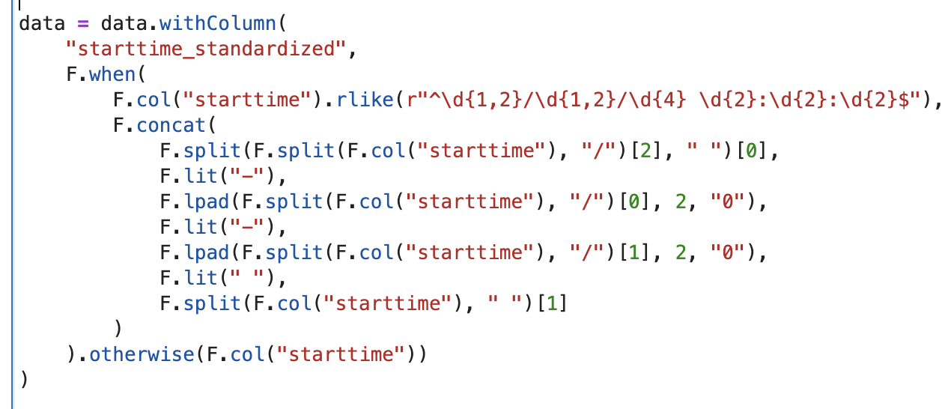
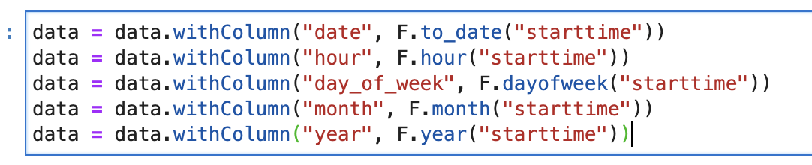
Data Preprocessing
Since we wanna achieve the task of predicting the hourly demand per station
The main feature we wanna use is starttime, but we found that due to schema change the date format changed over years in data
So we standardized the
date column and divided date
into multiple feature like
hour, day,month, year

Slide 11
Data Preprocessing
We engineered the target variable (demand) by grouping the data in dataset using columns date time and station name
We had total of 44 mil records in dataframe after this operation
During analysis we also found that we are missing data for years 2015 and 2016 due to date format in the dataset.
We also dropped all the rows with null values

Slide 12
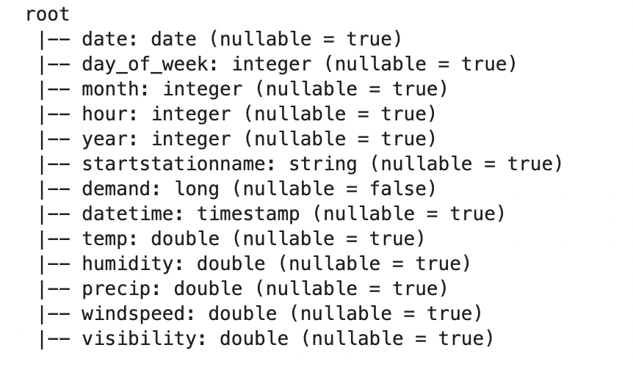
Data Preprocessing
Incorporating weather data
Sice bike rides are impacted by weather conditions we joined weather data to out citi bike dataframe based on hour, day of week, year columns

Slide 13
Data Processing
Incorporating weather data
Sice bike rides are impacted by weather conditions we joined weather data to out citi bike dataframe based on hour, day of week, year columns

Slide 14
Feature Engineering
We also added more features to our dataset
Is_weekend - feature which indicates if day is part of weekend or weekday
Is_lockdown - indicates if the days are part of COVID lockdown
Hour_bucket - indicates if it's morning, afternoon, evening
temp_is_weekend: A new column created by multiplying the temp (temperature) column with the is_weekend column.
humidity_is_weekend: Similarly, this column is created by multiplying humidity with is_weekend.
We added these columns because the impact of temperature (temp) or humidity (humidity) on demand might vary between weekends and weekdays

Slide 15
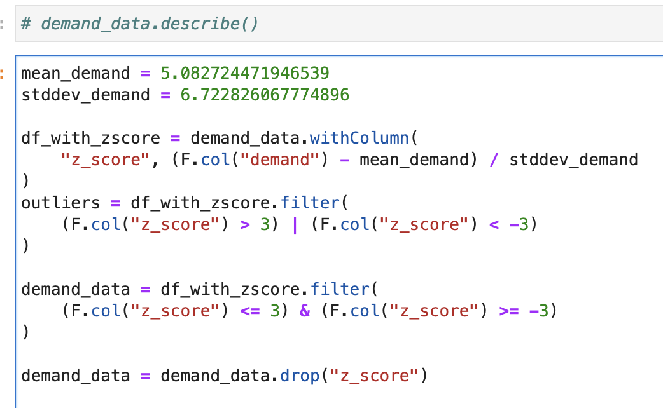
Feature Engineering
Outliers - During some cases we observed abnormal hourly demand for some stations
We identified outliers in demand using z-score methods and clean the data
After removing the Outliers the maximum demand per hour was 25 and minimum was 1 per station

Slide 16
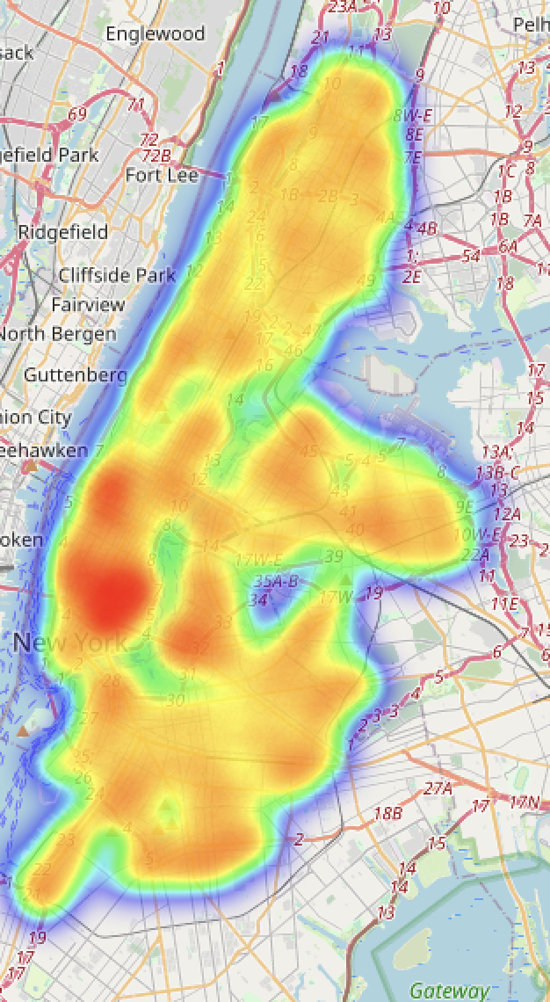
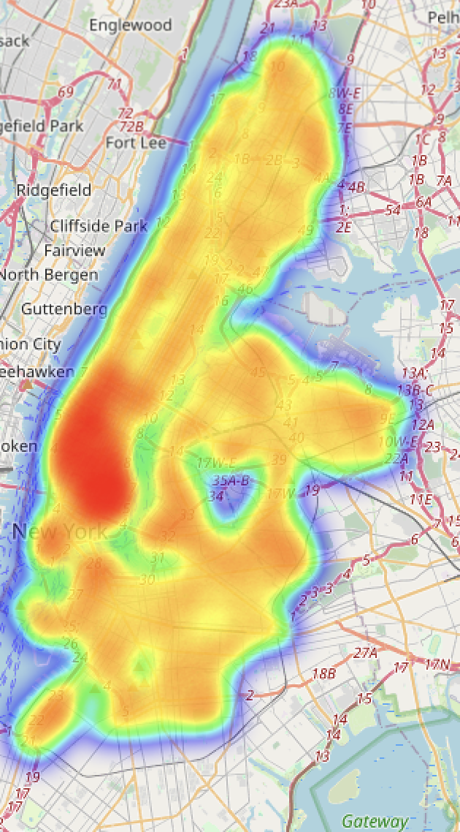
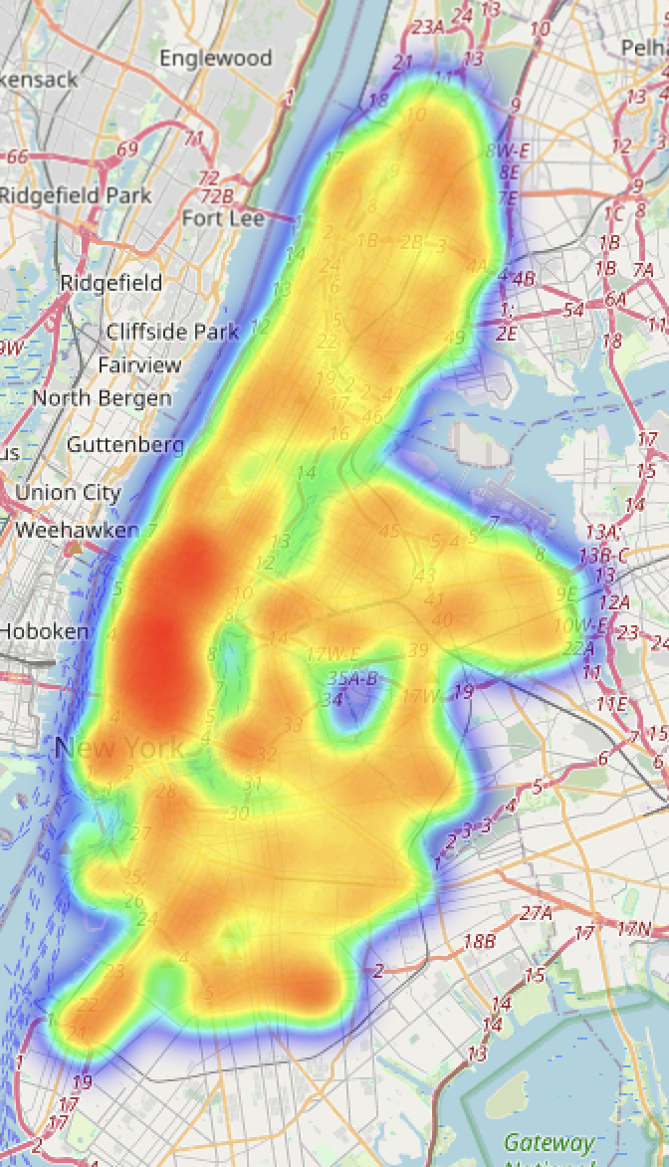
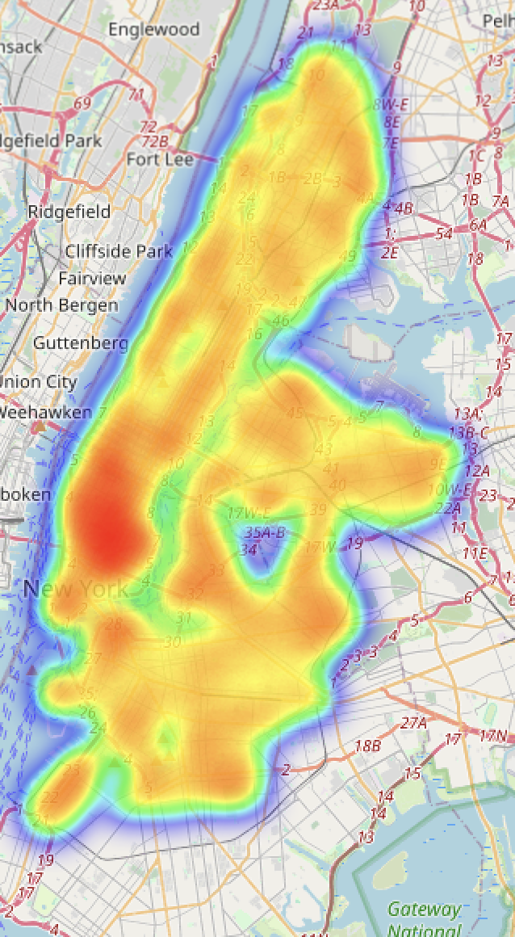
HEATMAP
12-6AM
6AM-12PM
12-6PM
6PM-12AM

Slide 17
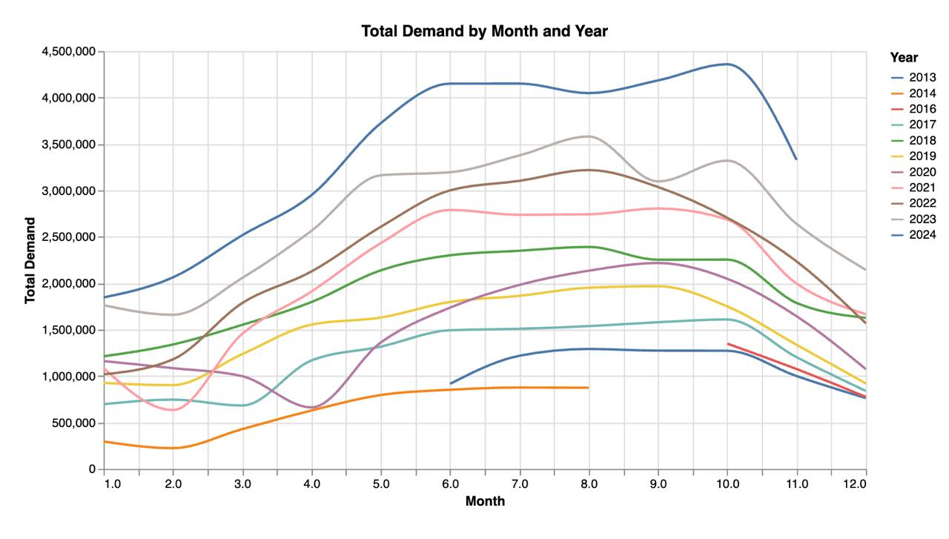
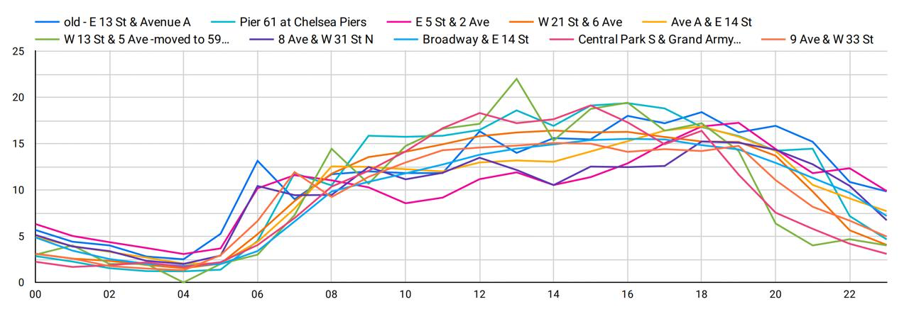
Data Visualization
Average demand per hour per station
⬇
⬆
Demand by month & year

Slide 18
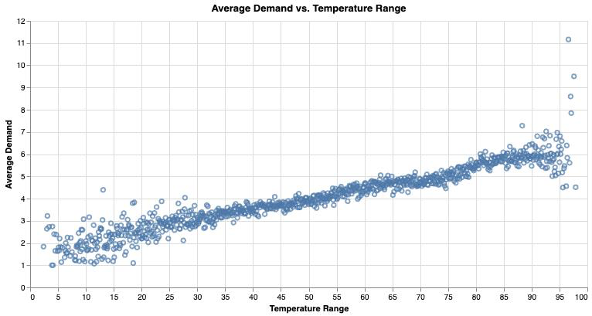
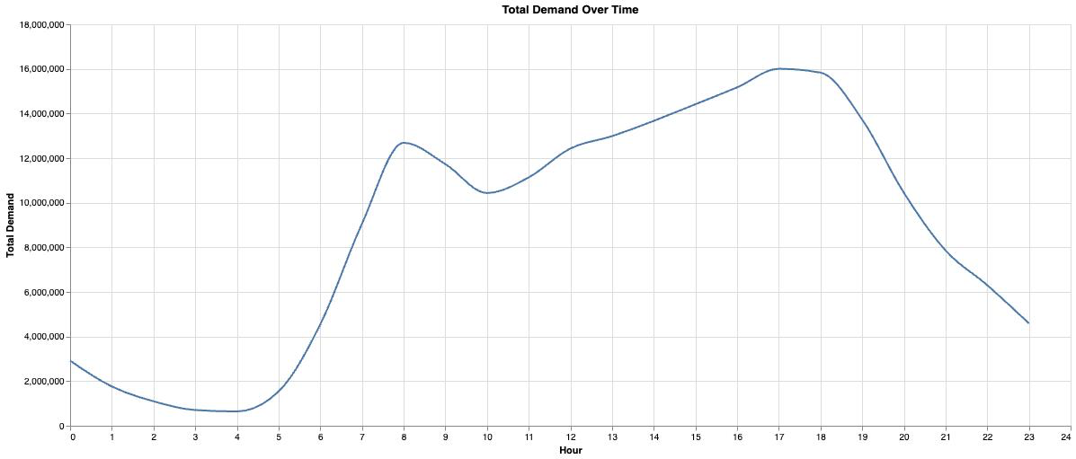
Data Visualization
Total demand over time of the day
⬇
⬆
Avg Demand by Avg Temperature

Slide 19
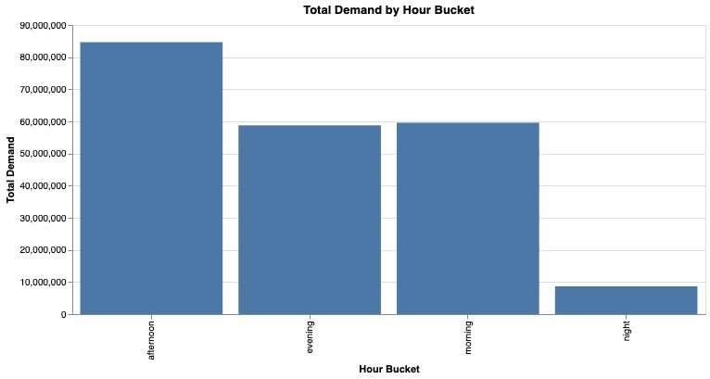
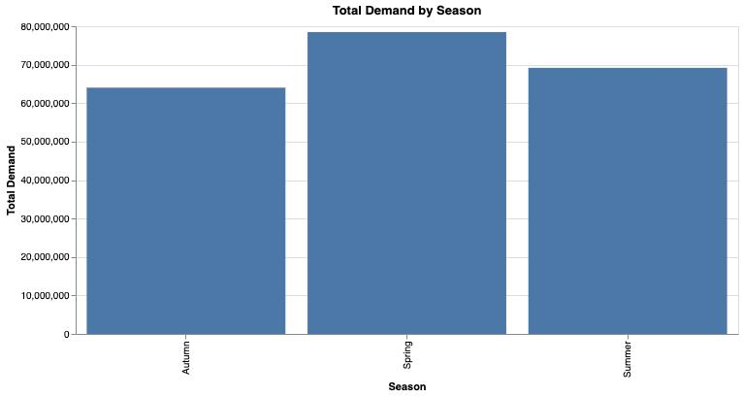
Data Visualization
Total demand by Season
⬇
⬆
Total Demand by Hour buckets

Slide 20
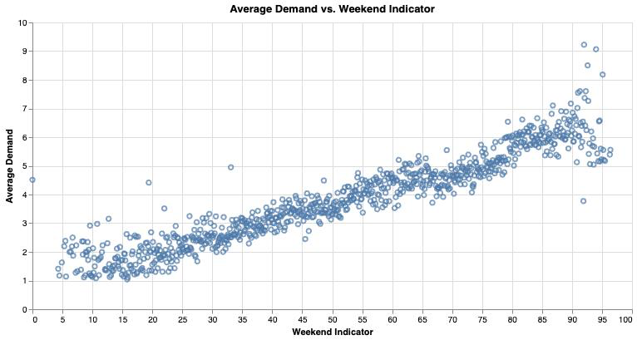
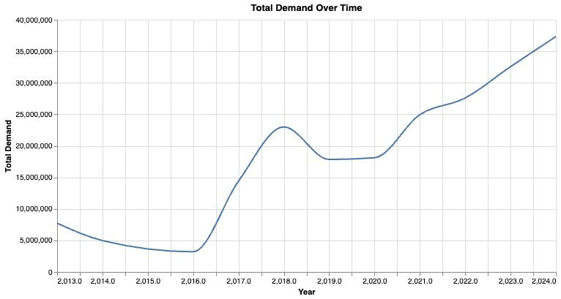
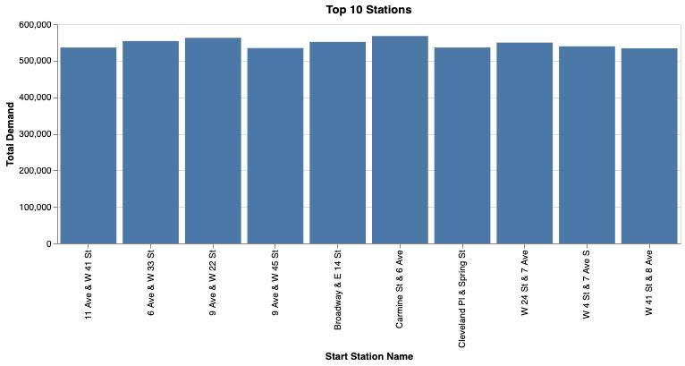
Visualization
Total demand over time of the day
⬇
Top 10 stations based on demand
⬇
⬆
Avg Demand by Weekend

Slide 21
MODEL PIPELINE
The pipeline consists of three main stages:
Vector Assembler
Standard Scaler
ML Model (Linear regression, Decision Tree, Random Forest, GBT )
VectorAssembler
Purpose: Combines multiple input features into a single vector.
StandardScaler
Purpose: Normalizes the feature vector for consistent scaling.

Slide 22
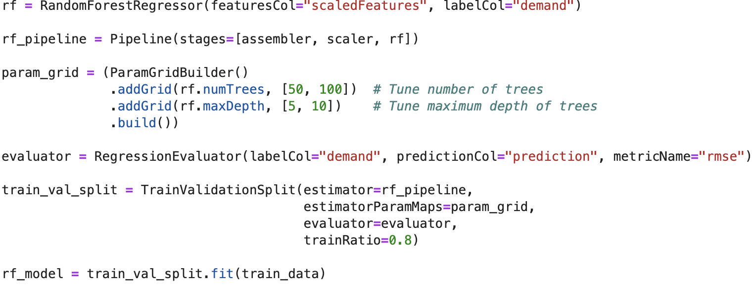
Random Forest Model
Data Preparation: Features are assembled and scaled for optimal model performance (assembler, scaler).
Model:
Random Forest Regressor: An ensemble learning method that combines multiple decision trees to improve prediction accuracy and handle complex data relationships.
Hyperparameters tuned:
Number of trees (numTrees): [50, 100]
Maximum depth (maxDepth): [5, 10]
Model Optimization:
Train-Validation Split:
80% training data, 20% validation data.
Evaluated using Root Mean Square Error (RMSE).
Grid search to find the best model.
Evaluation Metrics:
RMSE: Measures prediction error magnitude.
R²: Proportion of explained variance.
MAE: Average absolute error.
MSE: Mean of squared errors

Slide 23
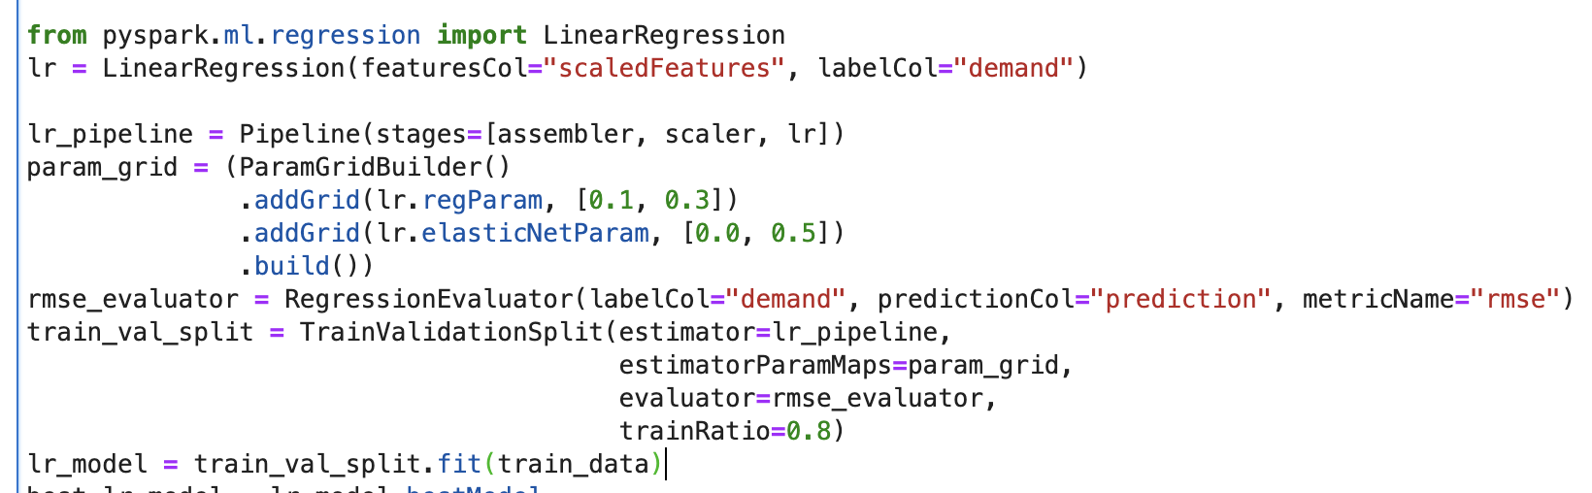
Linear Regression Model
Data Preparation: Features are assembled and scaled for optimal model performance (assembler, scaler).
Model:Linear Regression Regressor: A simple and interpretable model that predicts demand by assuming a linear relationship between features and the target variable.
Hyperparameters tuned:
Regularization parameter (regParam): [0.1, 0.3]
Elastic net mixing parameter (elasticNetParam): [0.0 (Ridge), 0.5 (ElasticNet)].
Model Optimization:
Train-Validation Split:
80% training data, 20% validation data.
Evaluated using Root Mean Square Error (RMSE).
Grid search to find the best model.
Evaluation Metrics:
RMSE: Measures prediction error magnitude.
R²: Proportion of explained variance.
MAE: Average absolute error.
MSE: Mean of squared errors

Slide 24
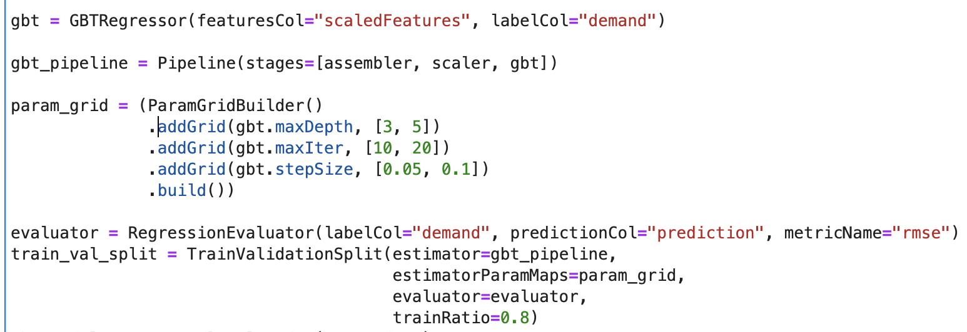
GBT Model
Data Preparation: Features are assembled and scaled for optimal model performance (assembler, scaler).
Model:GBT Regressor: A powerful ensemble model that builds trees iteratively to minimize prediction errors, effectively handling non-linear relationships and improving accuracy..
Hyperparameters tuned:
maxDepth: Maximum depth ([3, 5]).
maxIter: Maximum iterations ([10, 20]).
stepSize: Learning rate ([0.05, 0.1]).
Evaluation Metrics:
RMSE: Measures prediction error magnitude.
R²: Proportion of explained variance.
MAE: Average absolute error.
MSE: Mean of squared errors

Slide 25
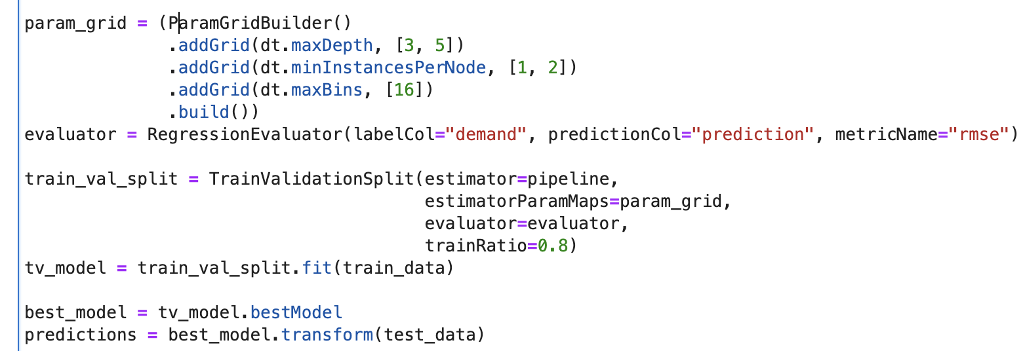
Decision Trees Model
Data Preparation: Features are assembled and scaled for optimal model performance (assembler, scaler).
Model:Decision Tree Regressor: A tree-based model that splits the data recursively to predict demand, handling non-linear relationships effectively.
Hyperparameters tuned:
maxDepth: Maximum depth of the tree ([3, 5]).
minInstancesPerNode: Minimum instances per node ([1, 2]).
maxBins: Maximum number of bins for continuous features ([16]).
Evaluation Metrics:
RMSE: Measures prediction error magnitude.
R²: Proportion of explained variance.
MAE: Average absolute error.
MSE: Mean of squared errors

Slide 26
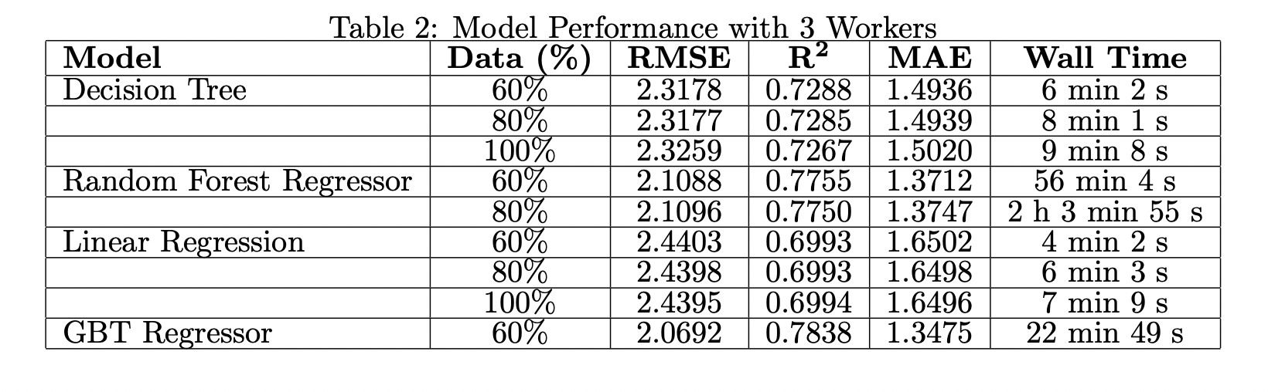
Model Evaluation
For each cluster configuration, the models were trained using different percentages of the total
dataset to evaluate the relationship between data volume and computational efficiency.
The data proportions used were:
60% of the dataset
80% of the dataset
100% of the dataset

Slide 27
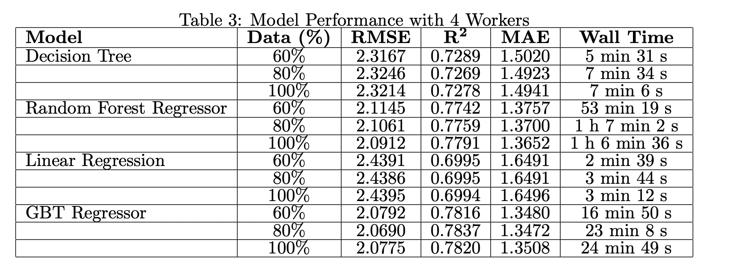
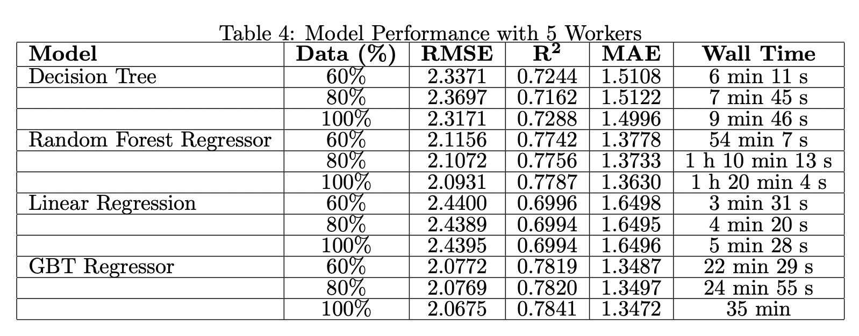
Model Evaluation

Slide 28
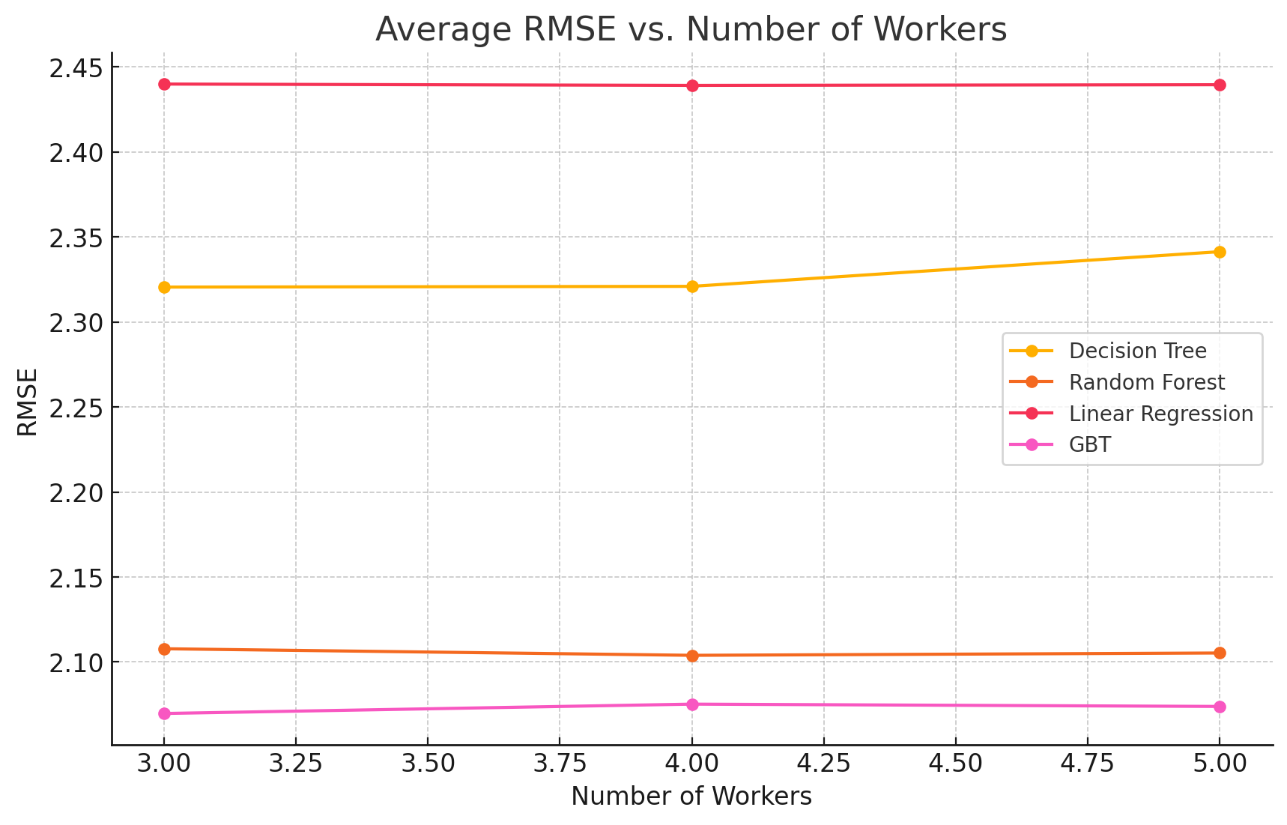
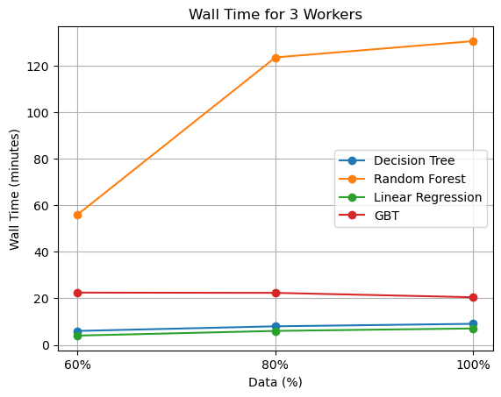
Model Evaluation
The execution time increased as we increased the portions of data over 3 workers
No Significant change in RMSE as workers are increased

Slide 29
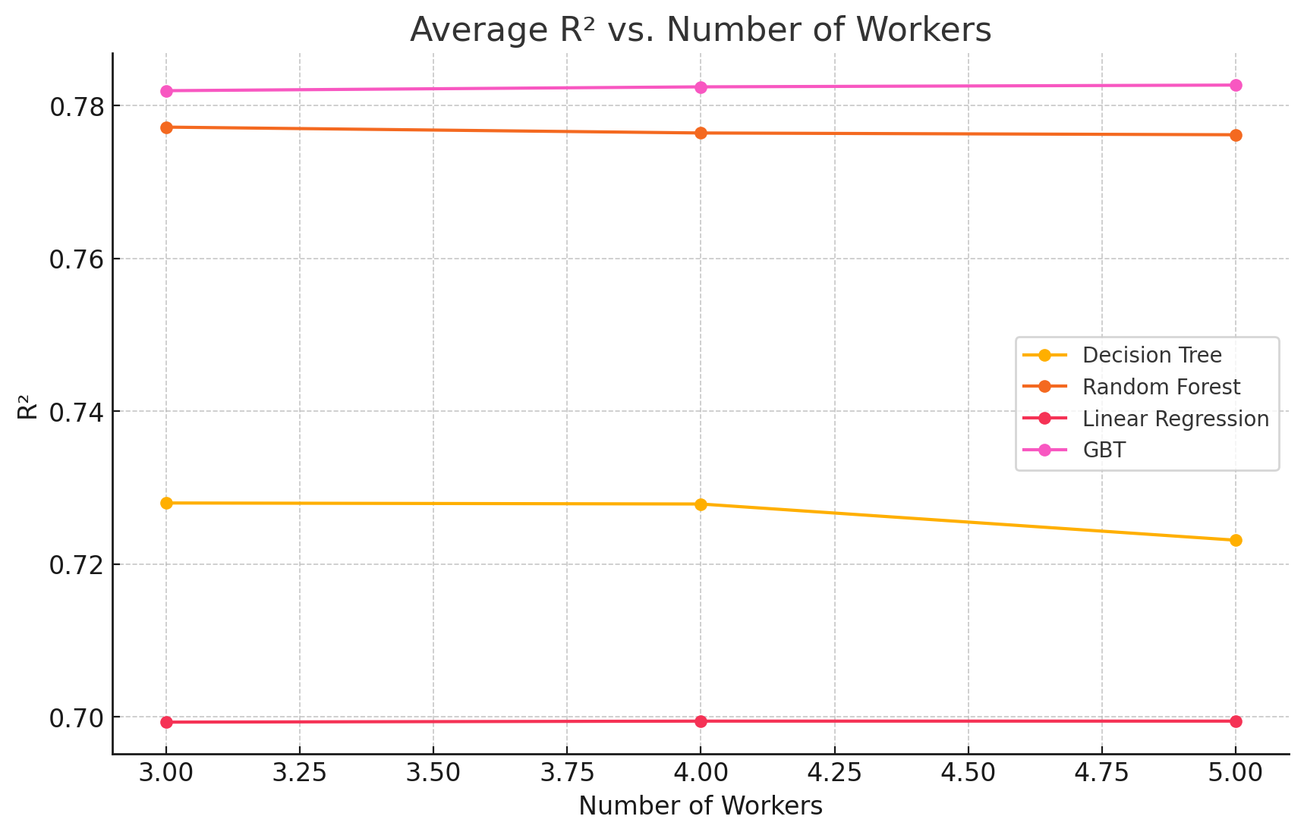
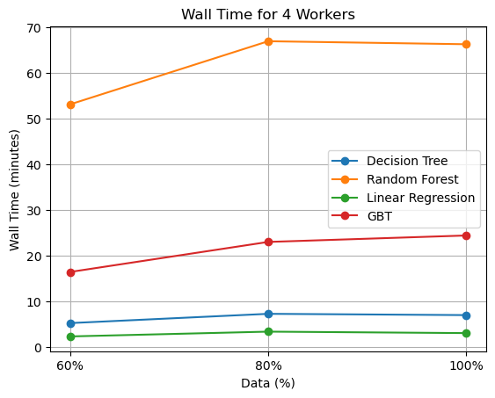
Model Evaluation
The execution time increased as we increased the portions of data over 4 workers

Slide 30
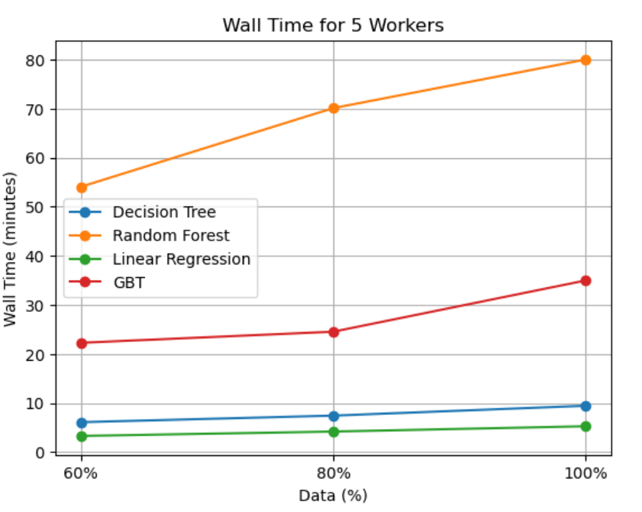
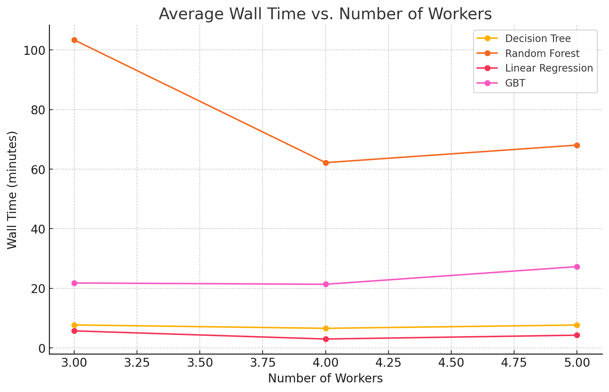
Model Evaluation
The execution time increased as we increased the portions of data over 5 workers

Slide 31
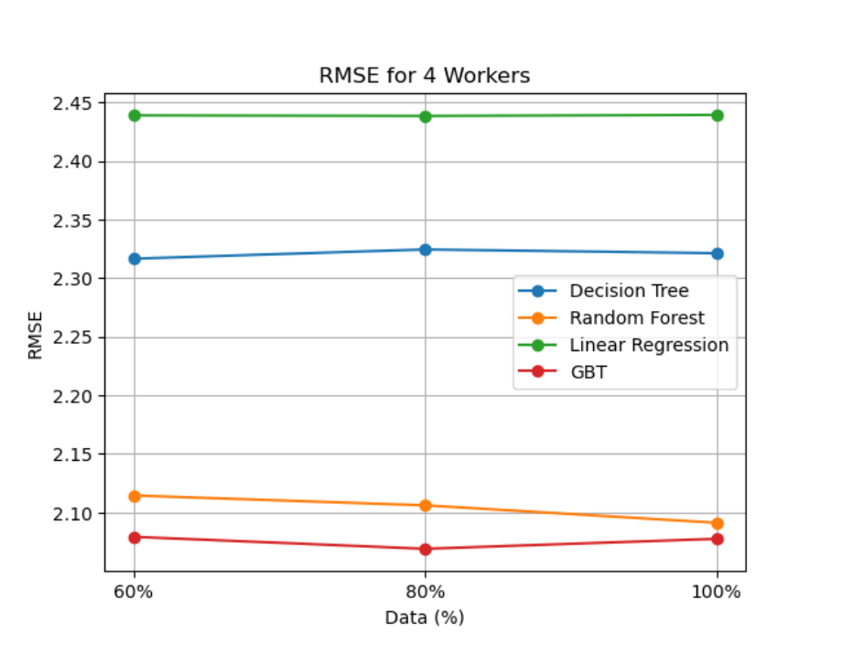
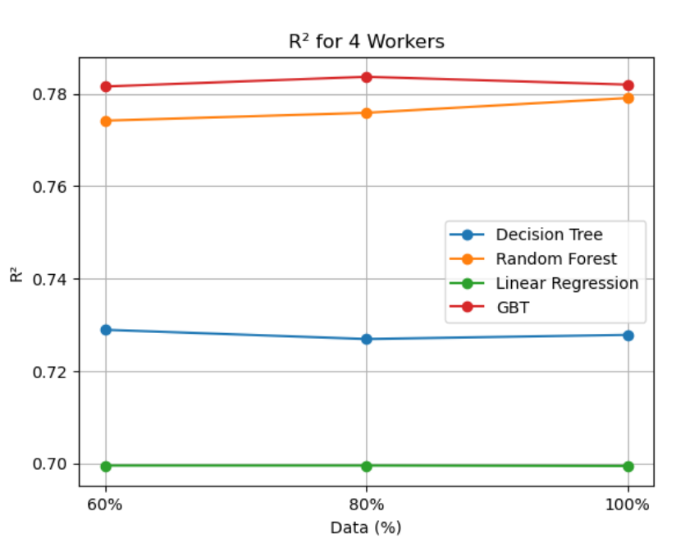
Model Evaluation
There is no significant increase in R2 and RMSE as we increased the portion of data

Slide 32
Conclusion
Overall, GBT consistently has the lowest RMSE across all worker groups.
Overall, GBT performs best in terms of R² across all worker groups and data percentages.
Overall, Linear Regression is the fastest model, with consistently low wall time across all workers and data percentages.

Slide 33
PROPOSED SOLUTION
User-incentives: Offer discounts or extra credits to return bikes to nearby underused docks(Bike Angels)
Extra charges: Charge extra based on time limits and high demand areas
Infrastructure management: Strategically place large stations in high-demand area
Loyalty program: To increase usage during winters, can introduce badges as well as prizes such as winter gear
Valet services: During peak times, valet services can be deployed to rebalance bikes
Real-time monitoring and rebalancing: Citibike crew can monitor real-time bike and dock usage and do rebalancing based on predicted demand

Slide 34
THANK YOU!

